Slide 1
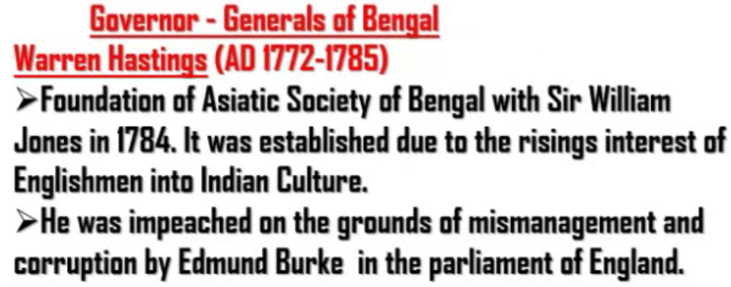
When British won Battle of Plassey and Battle of Buxar, they established the rule in Bengal.
At first there was no Viceroy. At first there was someone called Governor General of Bengal.
The first Governor General was Warren Hastings. He did not had the title of “Lord”

Slide 2
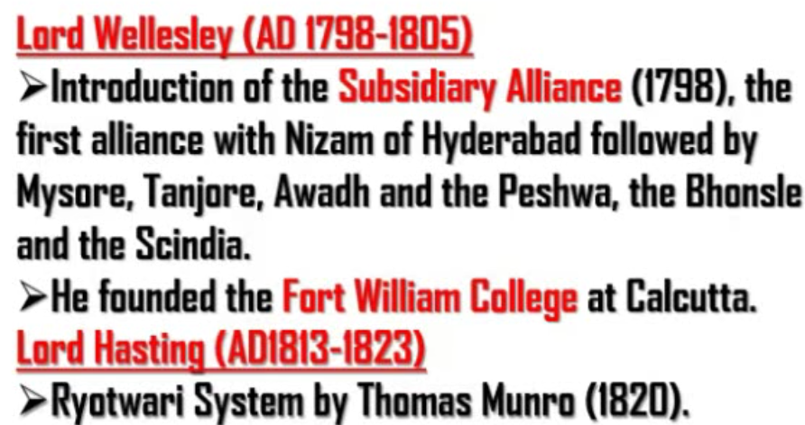
From Wellesley, Governor Generals of India got the title of “Lord”
Ryot – Farmer (They were generally poor)
Earlier there was a middlemen who collected taxes from poor farmers and then submitted it to govt.
As middlemen took commission, poor farmers had to pay more.
Thomas Munro under Lord Hasting introduced Ryotwari System according to which farmers paid the taxes directly to govt. and not the middlemen. In this way commission to middlemen did not come on the head of poor farmers.

Slide 3
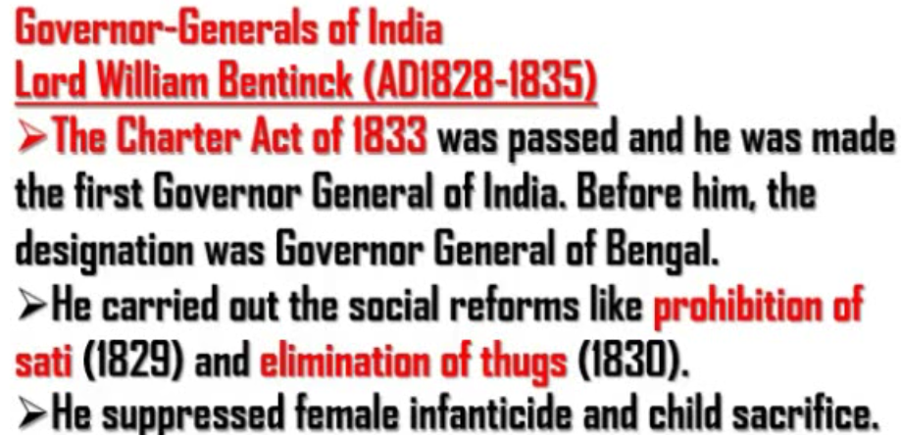
British expanded their rule from Bengal to almost all parts of India during Lord Hastings.
So, from Lord William Bentick, the rank of Governor General of Bengal raised to the rank of Governor General of India.

Slide 4
